Slide 1
SALARY SURVEY 2021 EXCEL & SQL
JAISURYA R
DADS
OCT 2024
30-01-2025

Slide 2
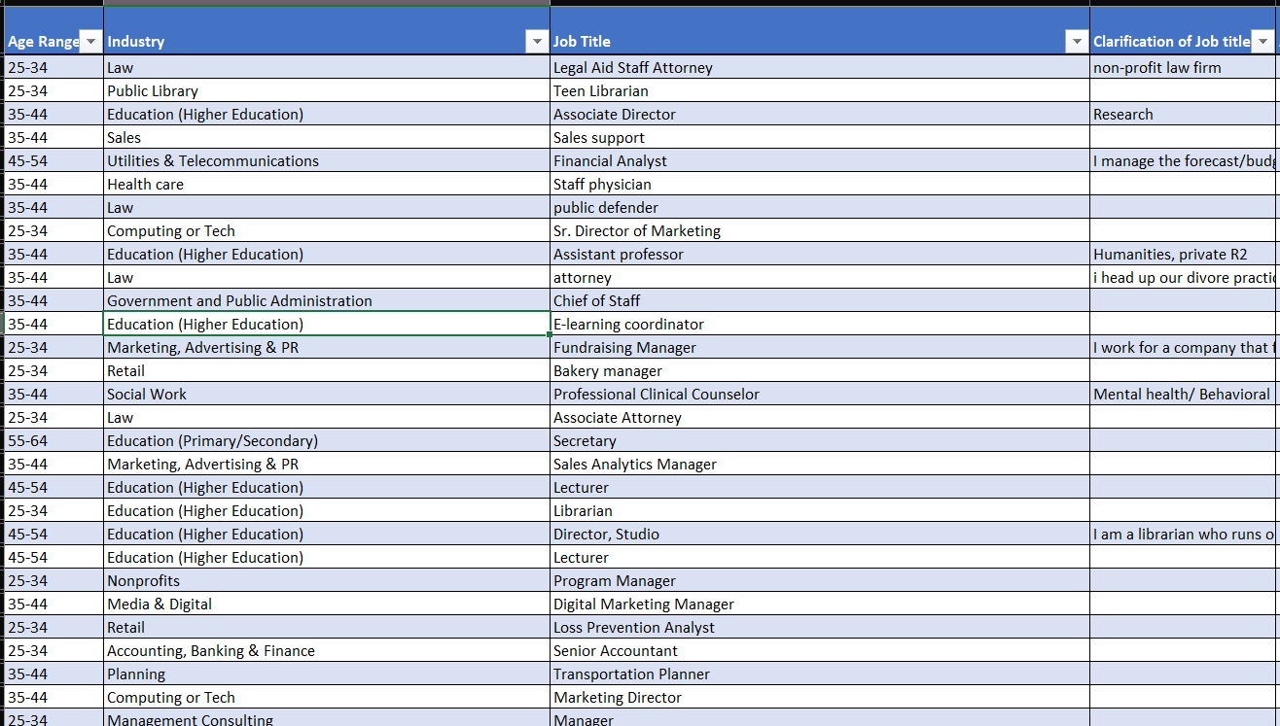
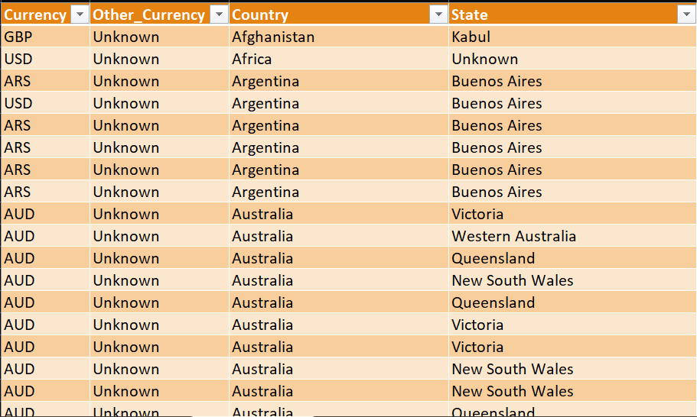
DATA CLEANING

Slide 3
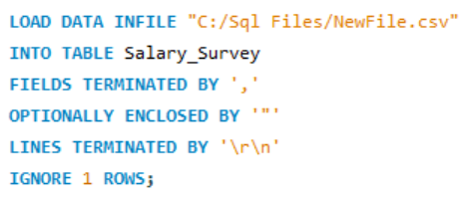
IMPORT DATA INTO SQL

Slide 4
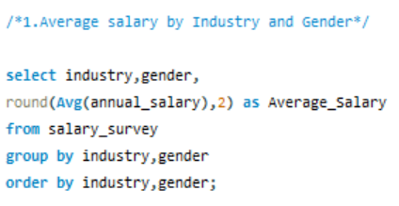
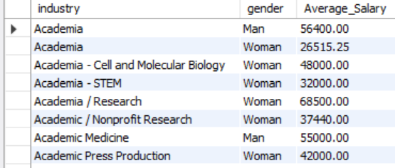
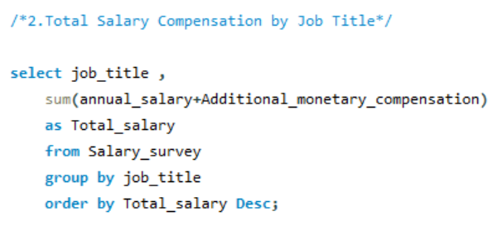
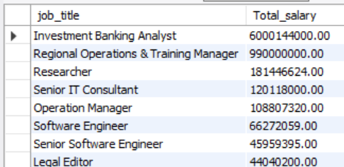
SQL-QUERY

Slide 5
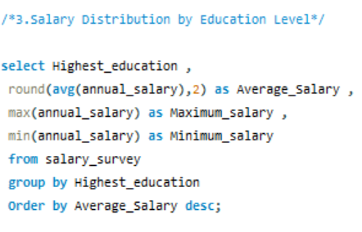
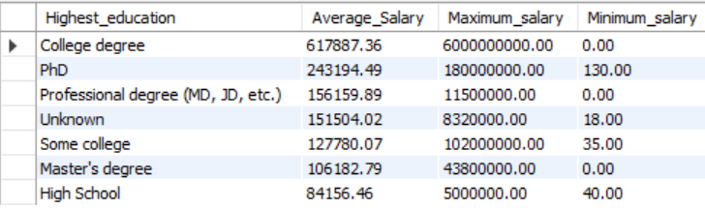
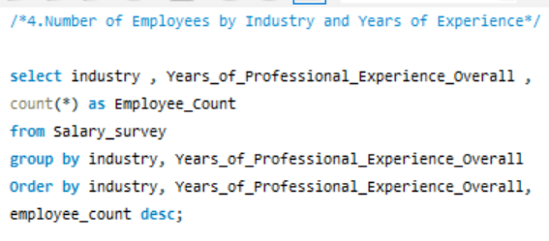
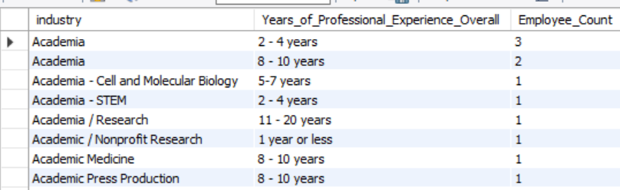
SQL-QUERY

Slide 6
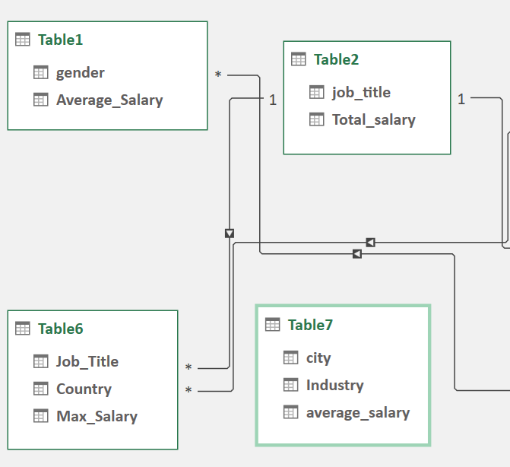
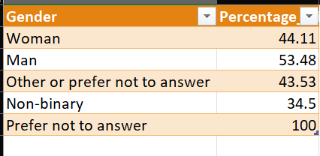
EXPORT DATA & TABLE SETUP

Slide 7
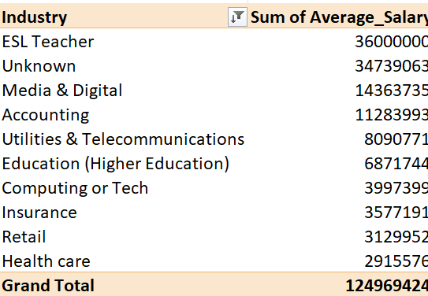
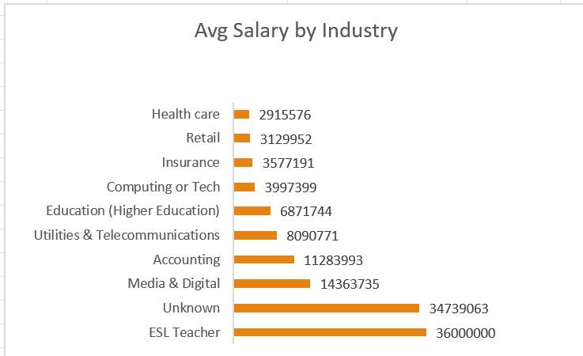
PIVOT TABLES & CHARTS

Slide 8
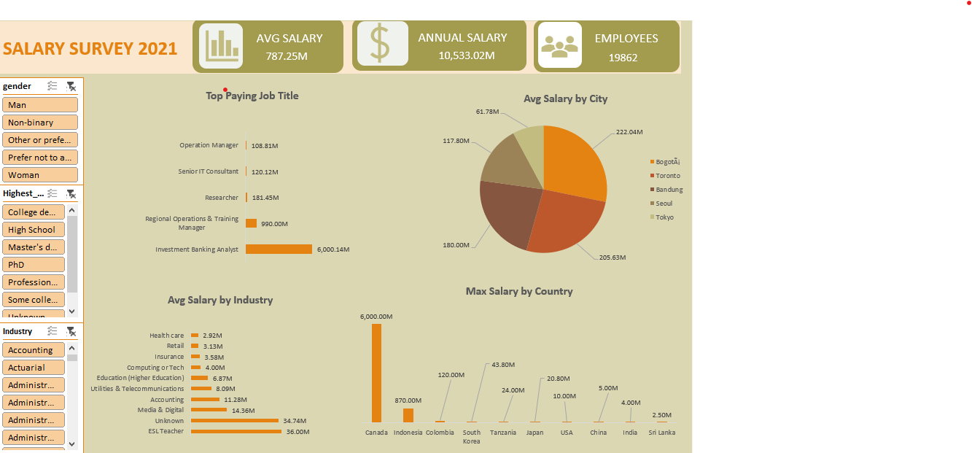
DASHBOARD

Slide 9
INSIGHTS & CONCLUSION
High paying job – Investment Banking Analyst
Maximum salary by Country – Canada
Minimum salary - Sri Lanka
Max , Min Avg Salary by City – Bogota , Tokyo
Avg Salary Higher for Women
High Avg Salary for Age Range > 65

Slide 10
THANK YOU

